Slide 1
Kronos Incident: Geospatial-Temporal Patterns of Life Analysis
Corey Vorsanger
COMP 4449
University of Denver

Slide 2
Pitch
Location data is abundant today with phones, etc.
It will only grow with more and more IoT data
Analysis of this data can help solve interesting problems
Such as law enforcement applications
Cut down on time spent in field
Allows detectives and other officers to focus on other more concrete tasks

Slide 3
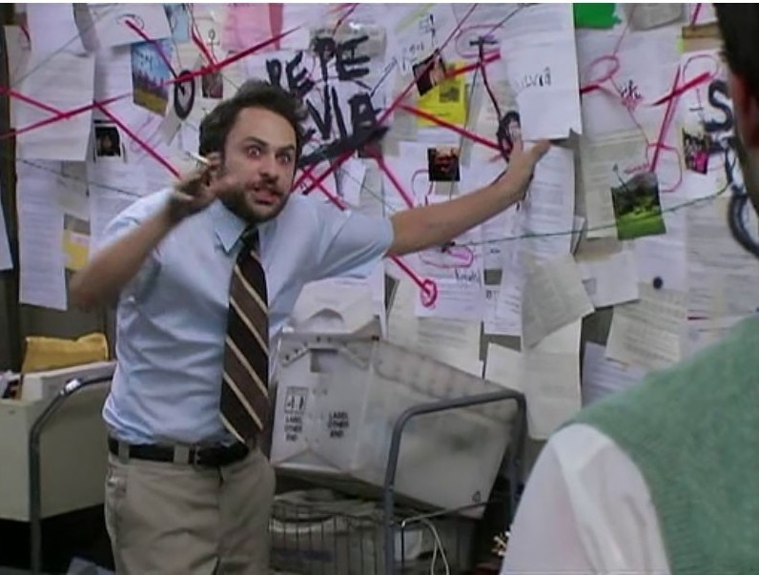
Personal Motivations
Never had worked on a project with location data before on a project.
Data Mining
Outlier Detection and how it might relate to future work
Synthesis of various data sources to find things of note
Go for Charlie Kelly

Slide 4
Initial Obstacles
Finding ways to merge the data sources into meaningful ways
Coming up with new features that give further insight
What are the best/relevant techniques in finding oddities in the dataset
Inconsistencies in the data
Intermittent location data
Credit Card transactions not always posted similarly (right-away vs. batch)
Who is represented in each data source

Slide 5
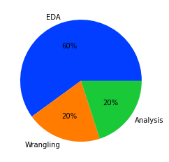
Development Time Commitment
Most time was spent on Exploratory Data Analysis
Included getting to know what is where in the csvs, descriptive statistics, and finding relationships between the datasets
Rest of the time was split into wrangling and analysis
Wrangling included merging the separate data frames and feature engineering
Analysis (data mining) was just finding inconsistency in the data through ML and pandas functionality
*Note: Data Visualization took place during the whole process

Slide 6
The Situation
In January, 2014, the leaders of GAStech are celebrating their new-found fortune as a result of the initial public offering of their very successful company.
During the celebration several employees of GAStech go missing.
In the aftermath several employees of GAStech go missing an organization known as the Protectors of Kronos (POK) is suspected.
Can we use data science techniques to uncover oddities in employees location and shopping data. This can further inform authorities in who they need to investigate in regards to the disappearances.

Slide 7
Proposed Goals of Investigation
Describe common daily routines for GAStech employees. What does a day in the life of a typical GAStech employee look like?
Identify up to twelve unusual events or patterns that you see in the data.
Considering data is primarily spatiotemporal, describe how you identified and addressed the uncertainties and conflicts inherent in this data to reach your conclusions in questions 1 and 2.

Slide 8
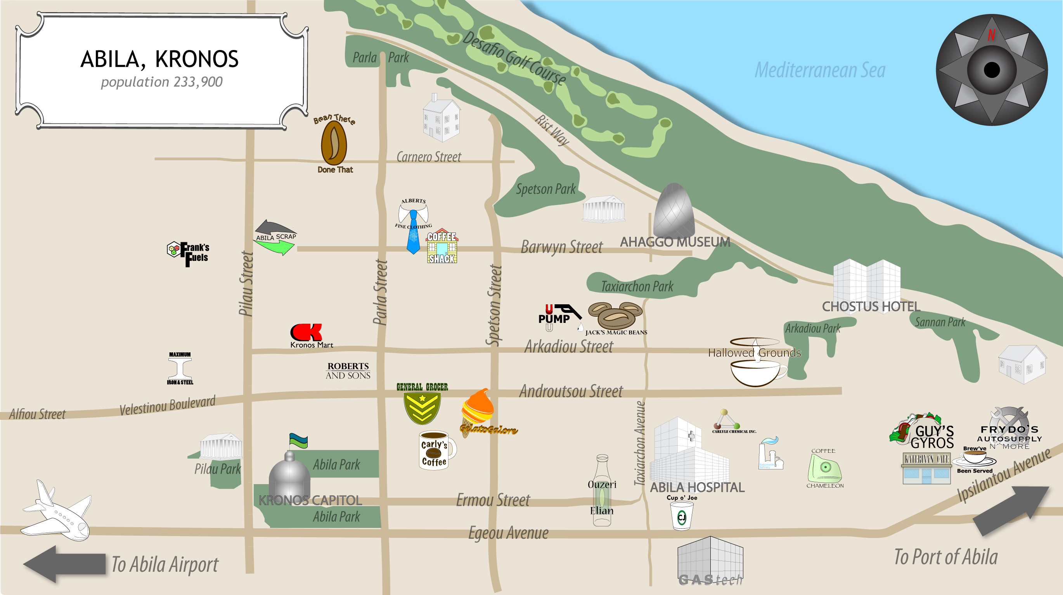
Abila, Kronos

Slide 9
The Dataset
Dataset consisted of 4 different csv files
Car dataset: Describing who has been assigned a company car
GPS: latitude & longitude of each car covering a two week period
Credit Card: Purchase price, location, and time on a persons credit card covering a two week period
Loyalty: Purchase price, location, and time when someone used a loyalty card covering a two week period
Other notable variables
Job position type & and job title in Car dataset

Slide 10
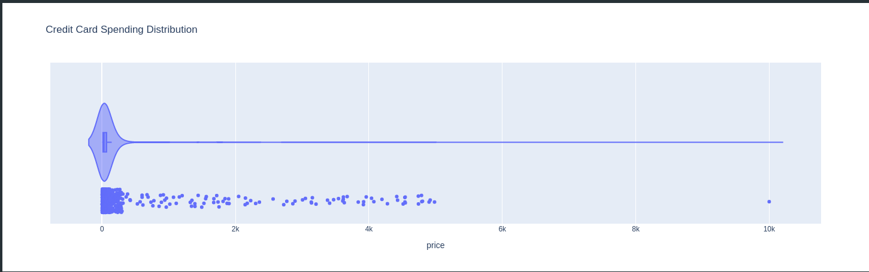
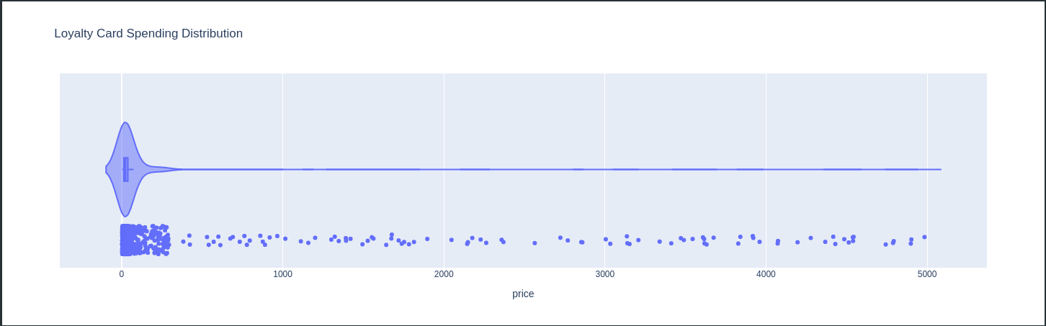
Purchases Distribution

Slide 11

Investigation Process
This was a very iterative process
Initial data analysis
Visualizations, GroupBys
Feature Engineering
Weekend Flag
Aggregate location intervals into 5 minute periods
Deeper dive into potential answers
LocalOutlierFactor, Isolating oddities with pandas

Slide 12
Question 1
Describe common daily routines for GAStech employees. What does a day in the life of a typical GAStech employee look like?

Slide 13
Daily Lives
First step was to try and establish daily typical patterns in the employees lives
Extensive use of heatmaps
Time-dependent, job type segmentation, and personal
Look at purchases that happening per hour
Abila residents love their coffee!
Patterns did depend a lot on job title
Typical weekday consisted of getting coffee, going to the office, getting lunch, job errands, getting dinner and then home
Weekends were a bit more fun with people going to the golf course, the museum, etc.

Slide 14
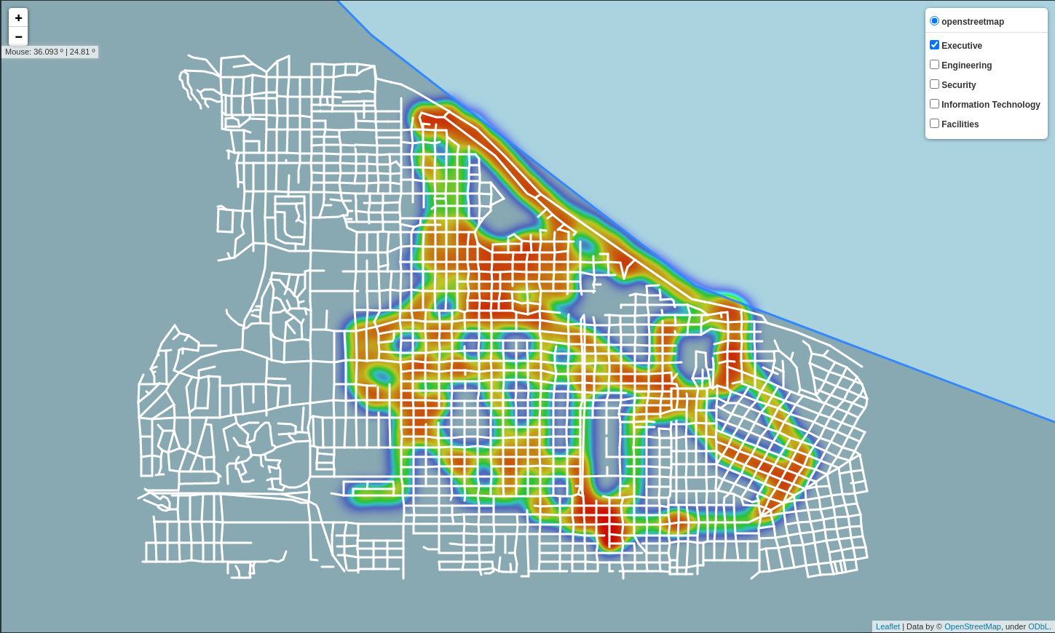
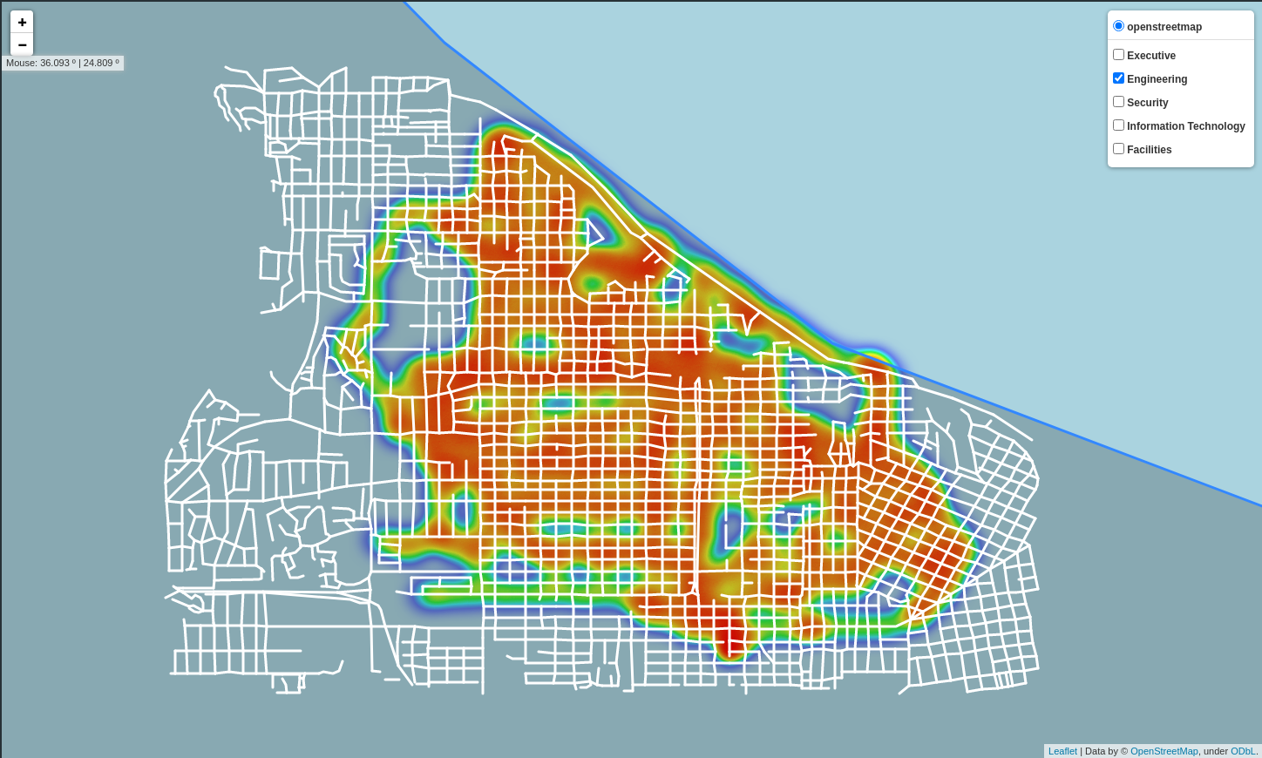
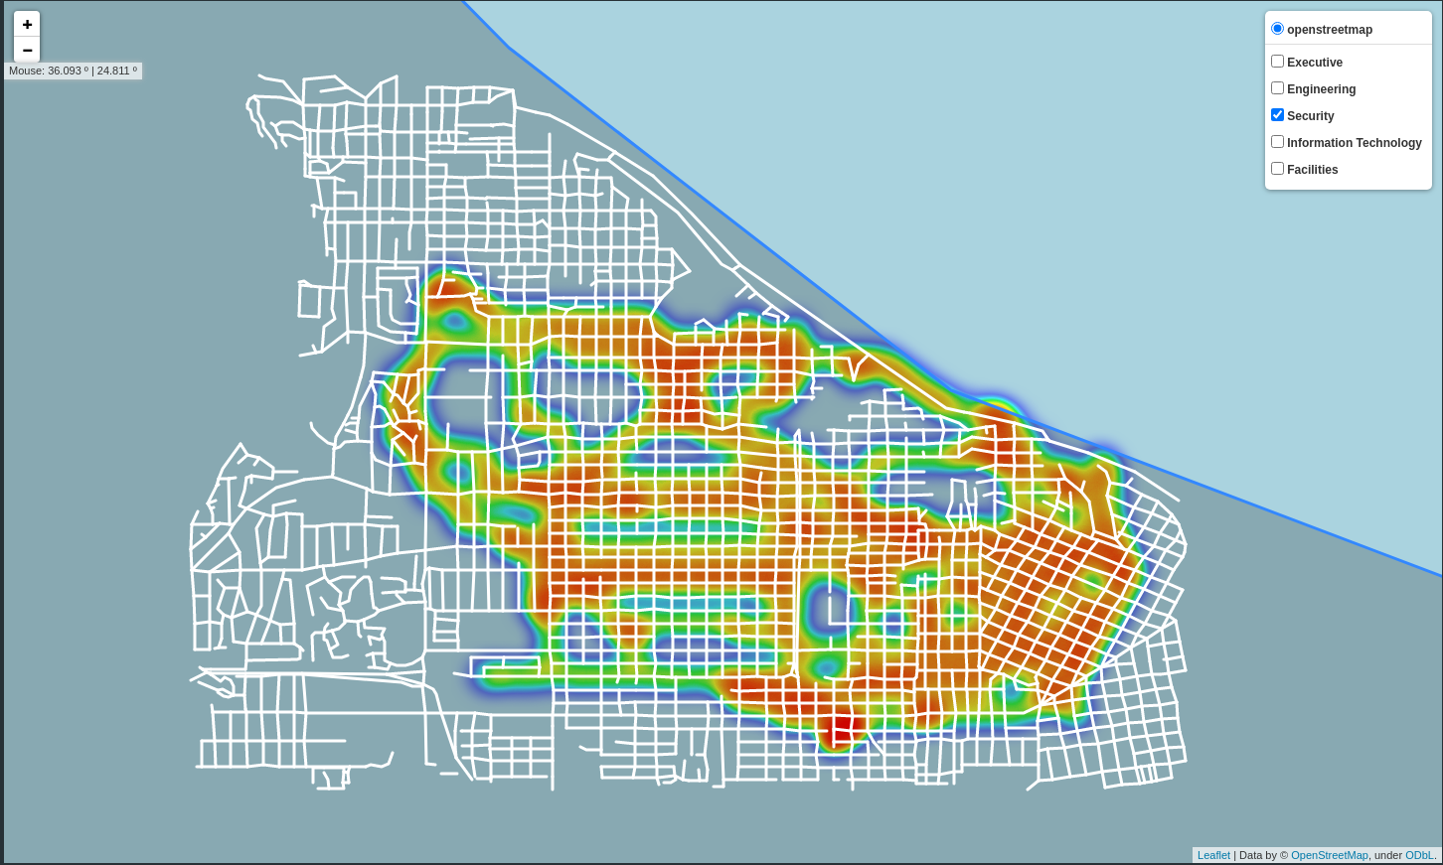
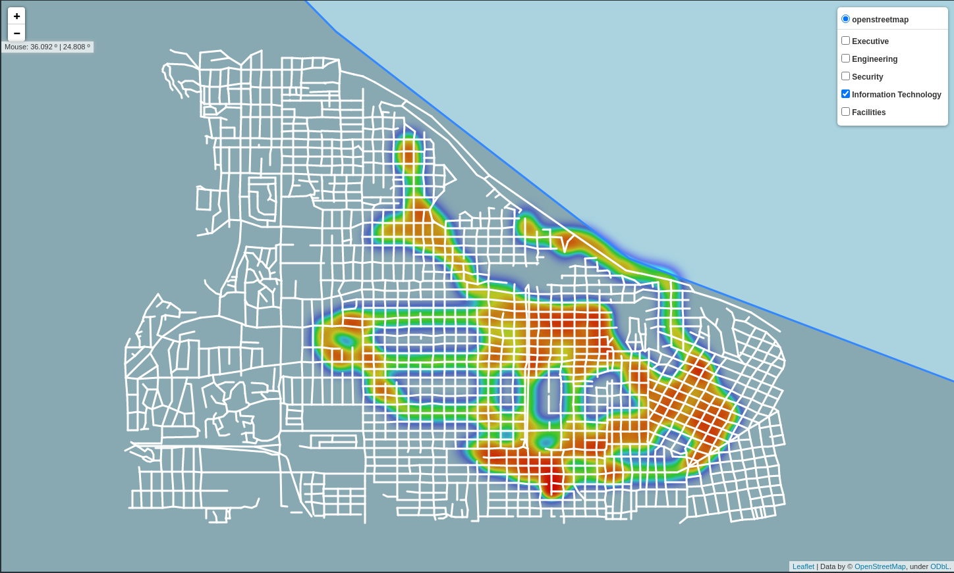
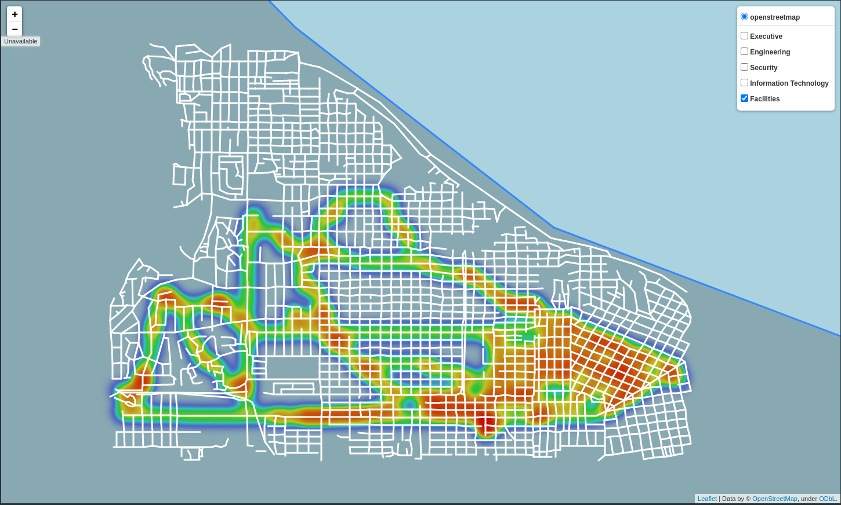
Job Type Heatmap
Executive
Engineering
Security
Information Technology
Facilities

Slide 15
Facilities Time Dependent HeatMap
Facilities Heatmap

Slide 16
Question 2
Identify up to twelve unusual events or patterns that you see in the data.

Slide 17
How?
There were a total 12 of potential suspects found
Done through finding abnormalities in locations and purchases
Mostly done through three avenues
LocalOutlierFactor: KNN based algorithm to find outliers
skleanrn.neighbors.LocalOutlierFactor
Uses density calculations to compare a point to its neighbors, densities that are substantially lower are considered outliers
Investigation of heatmaps (time dependent, per person, per job type)
Pandas functionality
Groupbys and mean/median/std calculations
Looked at per person, per job type, per job title, “groups”, and places

Slide 18
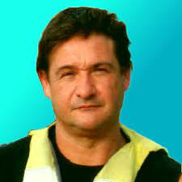
Most Interesting
Isia Vann (Perimeter Control)
Missed her daily morning stop at Brew’ve Been Served with Edvard
Had other transactions that day and location data ~7:00 AM
Sten Sanjorge Jr. (President/CEO)
Very high purchase at the Chostus Hotel ($600 when most were $110)
Only non Drill Technician
Only Weekend Purchase here
Claudio (Truck Driver)
While other truck drivers went to Aliba Airport many times he only went once
This was also the only Friday trip to the airport on either Friday (2 trips Wednesdays, 3-4 trips other weekdays)
*Note: Picture may not be accurate

Slide 19
Question 3
Considering data is primarily spatiotemporal, describe how you identified and addressed the uncertainties and conflicts inherent in this data to reach your conclusions in questions 1 and 2.

Slide 20
Dealing with Oddities
Few oddities in the purchases data
Credit Cards vs. Loyalty Cards
Sometimes detailed the same purchase with a different price
Used Loyalty Card price but Credit Card time
Sometimes purchases were uploaded in bulk, sometimes in real time
Add to remember this when looking at purchase time oddities
Intermittent location data; sometimes “holes” in a persons data
Resample the data taking the median location in 5/10/15/30 minute interval
Shifted location
Estimate the cars latitude and longitude when it is a GASTech and shift accordingly
Can’t just simply center as some cars tend to activity more southernly / easternly

Slide 21
Conclusion
Room for Improvement
More time to find other interesting behavior
Further investigation on ML techniques
Looking at purchases vs. location
This was a great project to work on
Learned and exercised location data analysis work flow
Sharpen tools on exploring data with Pandas
Visualization was key

Slide 22

Questions

